Slide 1


Social Buzz
Analysis

Slide 2


Today's agenda
Project recap
Problem
The Analytics team
Process
Insights
Summary

Slide 3

Social Buzz is a fast growing technology unicorn that need to adapt quickly to it's global scale. Accenture has begun a 3 month POC focusing on
these tasks:
An audit of Social Buzz's big data practice
Recommendations for a successful IPO
Analysis to find Social Buzz's top 5 most popular categories of content
Project Recap
Notes:
these tasks:
An audit of Social Buzz's big data practice
Recommendations for a successful IPO
Analysis to find Social Buzz's top 5 most popular categories of content

Slide 4


Problem
Over 100000 posts per day
36,500,000 pieces of content per year!
But how to capitalize on it when there is so much?
Analysis to find Social Buzz's top 5 most popularcategories of content

Slide 5
Process
1
Data Understanding
2
Data Cleaning
3
Data Modelling
4
Data Analysis
5
Uncover Insights

Slide 6
Data Understanding
Checked the datatypes,
Common columns between data frames
Null values presence in columns
Data Cleaning
Renamed the columns such that columns contains same data are labelled with same name
Dropped the unnecessary columns User Id, URL and Unnamed:0 from data frames
Drop the null values rows
Data Modelling
Merged the cleaned data frames based on the common column between data frames. In content and reactions data frames merged based on content Id column and the merged dataframe combined with reaction_type data frame based on reaction_type column.
The Combined data frame converted to csv file.
Data Analysis
Found top 5 Categories based on the total scores for each category found after groupby the categories.
Number of unique categories are there in categorical columns
Months with highest posts are evaluated.
Uncover Insights
Most Content type, Most reaction type
Relation between sentiment and reaction type
Relation between sentiment and content type
Relation between Category and Sentiment

Slide 7
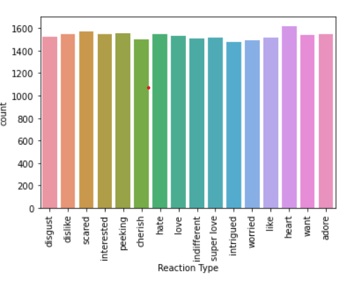
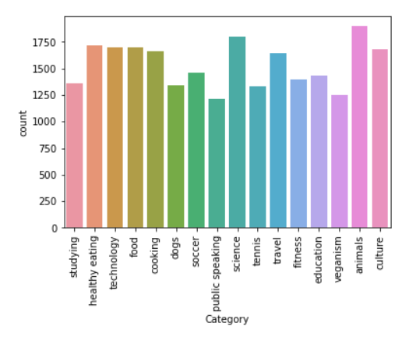

INSIGHTS
Heart reaction is the most common reaction type while remaining reaction type are almost same.
Animals and Science are most common categories while public speaking is least common category.

Slide 8
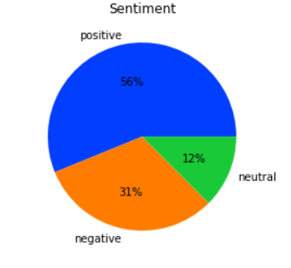
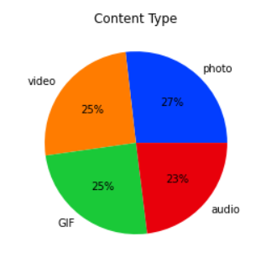
Content types photo, audio, video, GIF are almost same count in social Buzz. Among them Photo is the most common content type among all content types.
Most of the Social Buzz have positive sentiment followed by negative.

Slide 9
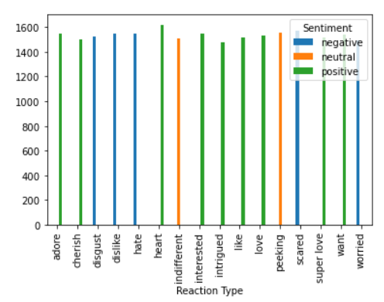
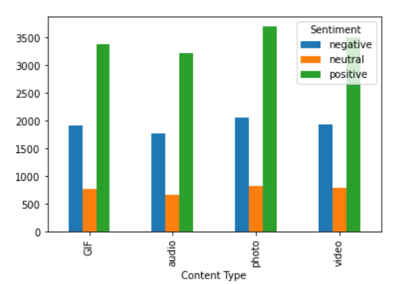
It is observed that photo content type has highest positive and negative sentiments among all the content types.
Heart has highest positive sentiment. Scared has highest negative sentiment. Peeking has highest neutral sentiment.

Slide 10

How many unique categories are there?
Ans: There are 16 unique category
How many reactions are there to the most popular category?
Ans: There are 16 reactions for most popular category.
Animal is the most popular category
What was the month with the most posts?
Ans: January Month has most posts.
Summary

Slide 11

Thank you!
ANY QUESTIONS?

